Slide 1





Part 6 – Building LLM-based Web Applications
Quang Duong

Slide 2
What We Will Build
Task-Specific AI assistants
Culinary AI Assistant
Marketing AI Assistant
Customer AI Assistant
SQL-querying AI Assistant
Travel AI assistant
Summarization AI Assistant
Interview AI Assistant
Simple AI chatbot
RAG (Retrieval Augmented Generation)-based AI chatbots
Chat with PDF, DOCX, CSV, TXT, Webpage
Agent-based AI chatbots
AI Chatbot with Math Problems
AI Chatbot with Search Problems

Slide 3
Backend & Frontend frameworks
In the scope of this course, I choose
Backend with Python
LLMs: OpenAI API GPT-3.5
LLM orchestrator: LangChain
Vector database: FAISS
External tools: Wikipedia, Tavily
Frontend with Python
Gradio

Slide 4
Task-Specific AI Assistants

Slide 5


Task-Specific AI Assistants
Trained on publicly available, non-private data up to a certain point in time.
Answer
Customized prompt based on user's requests
+
Add specific requests on a task
LLMs
User

Slide 6
Task-Specific AI Assistant Apps
Culinary AI assistant
Marketing AI assistant
Customer AI assistant
SQL-querying AI assistant
Travel AI assistant
Summarization AI assistant
Interview AI assistant
…

Slide 7
General Code-Snippet for AI Assistant
# Load the environment variables
load_dotenv()
# Initialize the chat model, i.e. gpt-3.5-turbo
llm = ChatOpenAI(model_name="gpt-3.5-turbo", temperature=0)
# Define the prompt template
prompt_template = """
You are an XXX assistant.
Following is the scenario that you need to respond to:
{request}
"""
# Create a prompt
prompt = PromptTemplate(
input_variables=["request"],
template=prompt_template)
# Create LLM chain
chain = prompt | llm | StrOutputParser()
# Get response
response = chain.invoke({"request":prompt})

Slide 8
Culinary AI Assistant

Slide 9
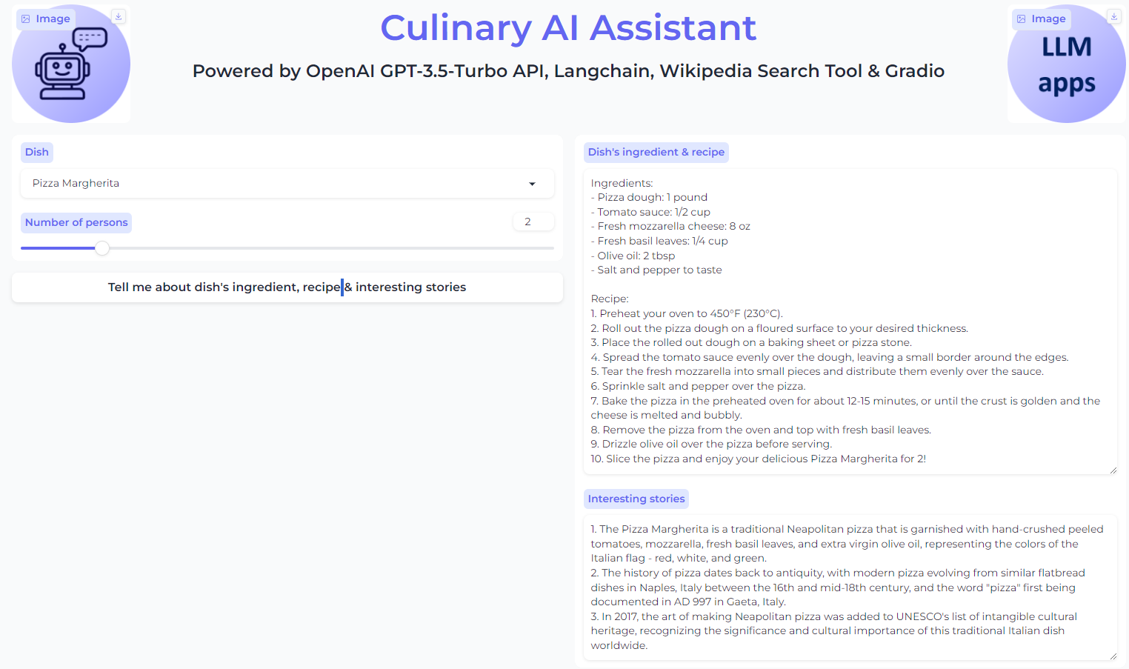
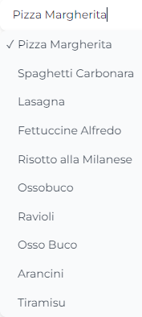
Culinary AI Assistant

Slide 10
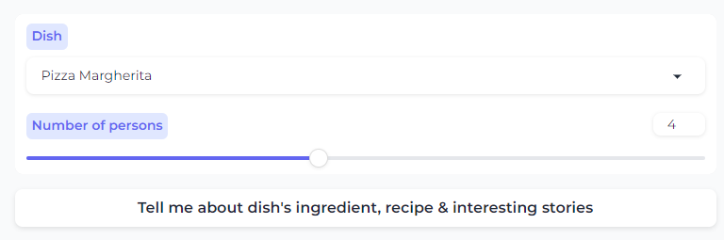
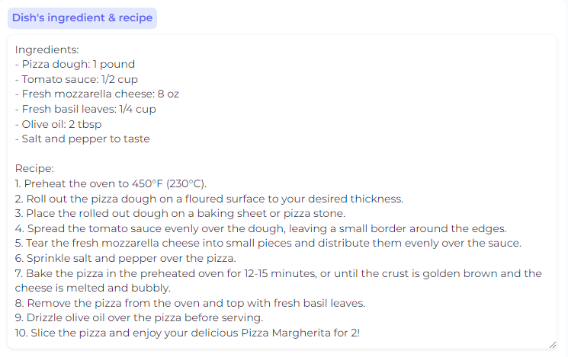
Parameterizing Prompt
recipe_prompt = f"""Present the recipe of {dish} for {no_per} persons. Return the response in 2 parts: Ingredients and Recipe.
For the Ingredients part, use the format as ingredient name : ingredient quantity.
For the Recipe part, make it clearly step by step."""
# Generate the recipe
recipe_response = chain.invoke({"request": recipe_prompt})

Slide 11
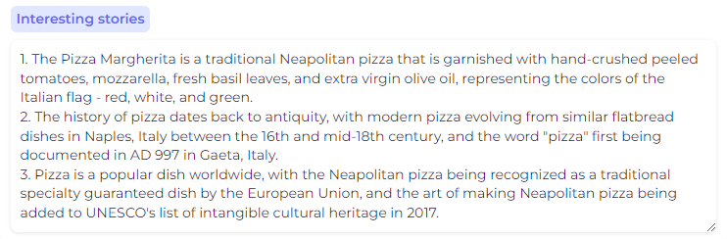
Search Tool + Parameterized Prompt
# Define the prompt for the Wikipedia query
wiki_prompt = f"origin story of {dish}"
# Run the Wikipedia query with the defined prompt
wiki_result = wikipedia.run(wiki_prompt)
# Define the prompt for generating the story
food_story_prompt = f"""Present the 3 most interesting stories or facts about {dish}, one sentence for each, using this search data {wiki_result}"""
# Invoke the LLMChain with the story prompt to generate the story
food_story_response = chain.invoke(
{"request": food_story_prompt}
)

Slide 12
What We Have Learned
This app allows us to
Parameterize efficiently prompt based on interactive user-input interface
Combine parameterized prompt with search tool like wikipedia

Slide 13
Marketing AI Assistant

Slide 14
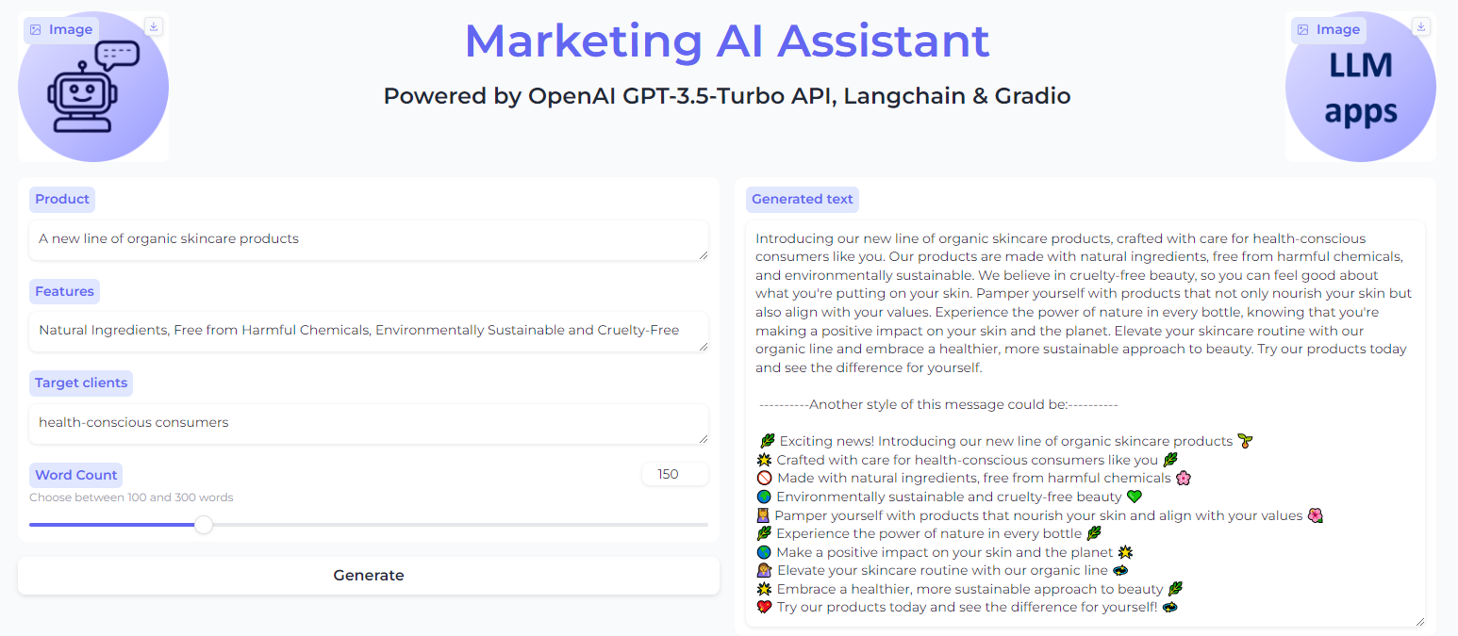
Marketing AI assistant

Slide 15
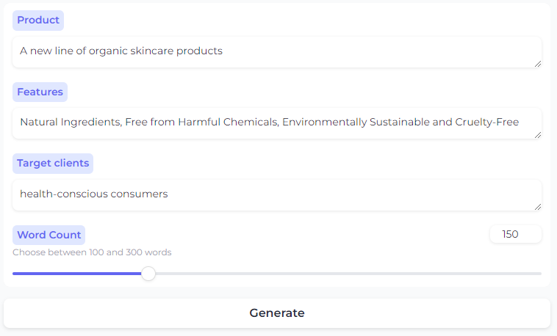
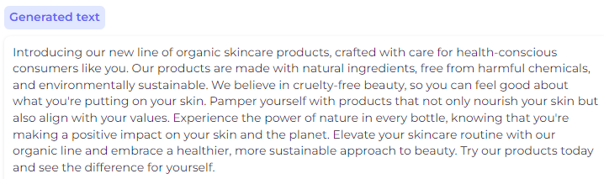
First Prompt
request = f"""
Write a marketing message describing the product that is {product}, that has the features {features}.
The message is targeting towards {target_clients}.
The response should be no more than {word_limits} words.
"""
# Generate the marketing message
marketing_message = chain.invoke({"request": request_marketing})

Slide 16
Second Prompt
# Request for new marking message
request_marketing_new_style = f"""
Use the following paragraph
Paragraph: {marketing_message}
Present it as another format with upbeat tone and emojis, main points in new lines.
"""
marketing_message_new_style = chain.invoke({"request": request_marketing_new_style})

Slide 17
Combining All Responses
# Define the text to separate the original and new styles of the marketing message
text = "----------Another style of this message could be:----------"
# Combine the original and new styles of the marketing message into the final result
final_result = f"{marketing_message} \n\n {text}\n\n {marketing_message_new_style}"

Slide 18
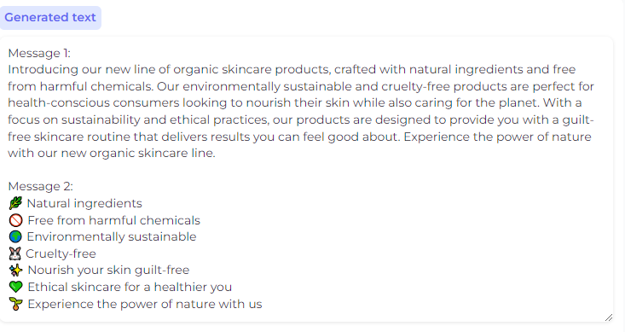
All-In-One Prompt
request_marketing = f"""
Write two marketing messages describing the product that is {product}, that has the features {features}.
The message is targeting towards {target_clients}.
The first message should be as a paragraph in a professional tone, and the second message should be in main points in new lines with upbeat tone and emojis.
Each message should be no more than {word_limits} words.
"""

Slide 19
What We Have Learned
This app allows us to
understand how to create a chain of prompts, i.e. the result of the first prompt will be the input of the second one, etc. That allows us to create more tailored responses
create multiple responses in different styles based on only one prompt
Inputs 1
Response 1
Response 2
Prompt 1
Prompt 2
Response 1
Inputs
One prompt
Response 2
…

Slide 20
Customer AI Assistant

Slide 21
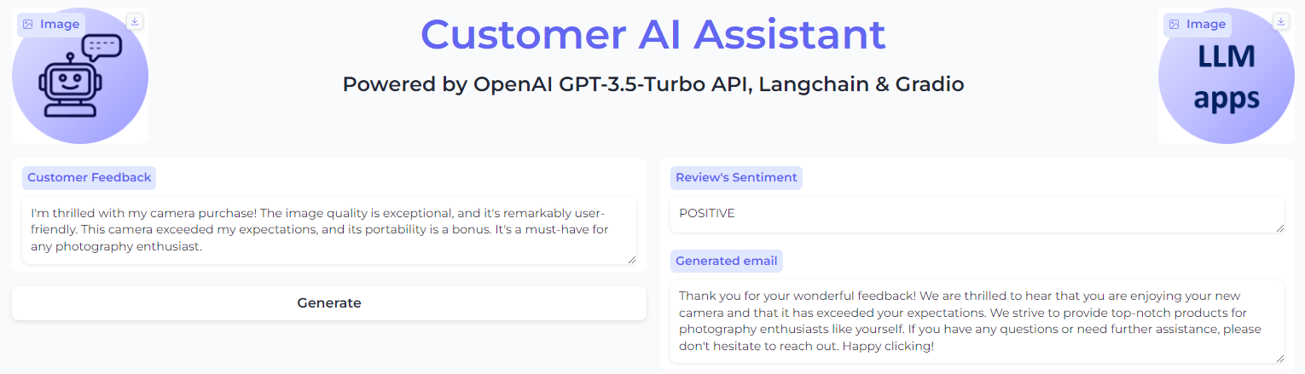
Customer AI Assistant

Slide 22
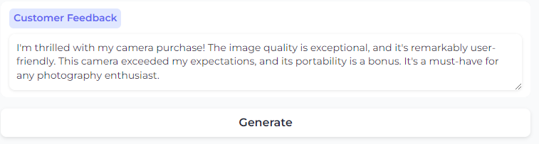
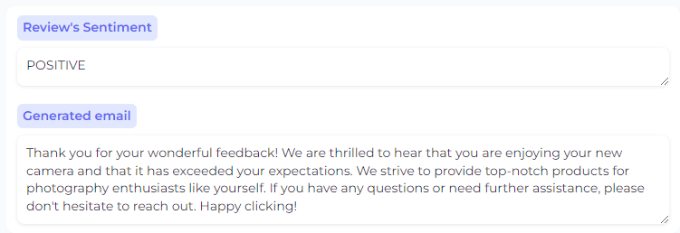
Requesting output in a specific format
request = f"""
You received a client feedback: {client_feeback}. Determine the sentiment of the feedback and write an email to response to the client, no more than 100 words. The sentiment should be one of the following: POSITIVE, NEUTRAL, NEGATIVE.
Format the response as a JSON object with the following keys: 'sentiment' and 'response'.
"""
# Get response
response = chain.invoke({"request": request})
# Parse the response as a JSON object
response = json.loads(response)
# response["sentiment"]
# response["response"]

Slide 23
What We Have Learned
Asking output as a specific format, e.g. json
making it easy to integrate into applications

Slide 24
SQL-Querying AI Assistant

Slide 25
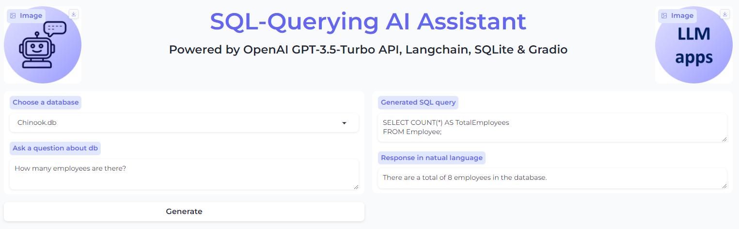
SQL-Querying AI Assistant

Slide 26
SQL-Querying AI Assistant
def predict_query(db_name, question):
if llm is None:
main()
# Define the template for the SQL query prompt
template_sql = """Based on the table schema below, write a SQL query that would answer the user's question:
{schema}
Question: {question}
SQL Query:
"""
prompt_sql = ChatPromptTemplate.from_template(template_sql)
# Connect to the database
db = SQLDatabase.from_uri("sqlite:///./{}/{}".format(DB_DICTIONARY, db_name))
# Define a function to get the table schema from the database
def get_schema(_):
return db.get_table_info()
# Define the chain to generate the SQL query
chain_sql_query = (
RunnablePassthrough.assign(schema=get_schema)
| prompt_sql
| llm.bind(stop=["\nSQLResult:"])
| StrOutputParser()
)

Slide 27
SQL-Querying AI Assistant
Define the template for the final prompt
template_final = """Based on the table schema below, question, sql query, and sql response, write a natural language response: {schema}
Question: {question}
SQL Query: {query}
SQL Response: {response}
"""
# Create a chat prompt template from the final template
prompt_final = ChatPromptTemplate.from_template(
template_final)
# Define the chain to generate the natural language response
chain_final = (
RunnablePassthrough.assign(query=chain_sql_query)
| RunnablePassthrough.assign(
schema=get_schema,
response=lambda x: db.run(x["query"]),
)
| prompt_final
| llm
| StrOutputParser()
)
# Generate the SQL query
sql_query = chain_sql_query.invoke({"question": question})
# Generate the natural language response
natural_language_response = chain_final.invoke({"question": question})
# Return the SQL query and the natural language response
return sql_query, natural_language_response

Slide 28
What We Have Learned
Natural language to SQL conversion
Schema utilization for accurate query generation
Integration and response generation

Slide 29
More App Ideas to Explore on Your Own! 😉

Slide 30
Travel AI Assistant

Slide 31
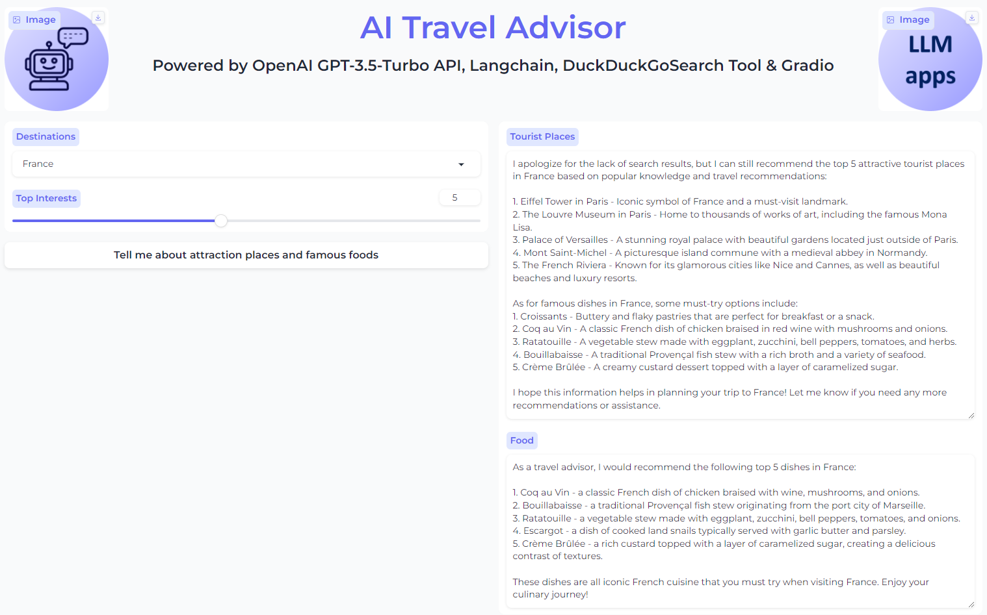
Travel AI Assistant

Slide 32
Summarization AI Assistant

Slide 33
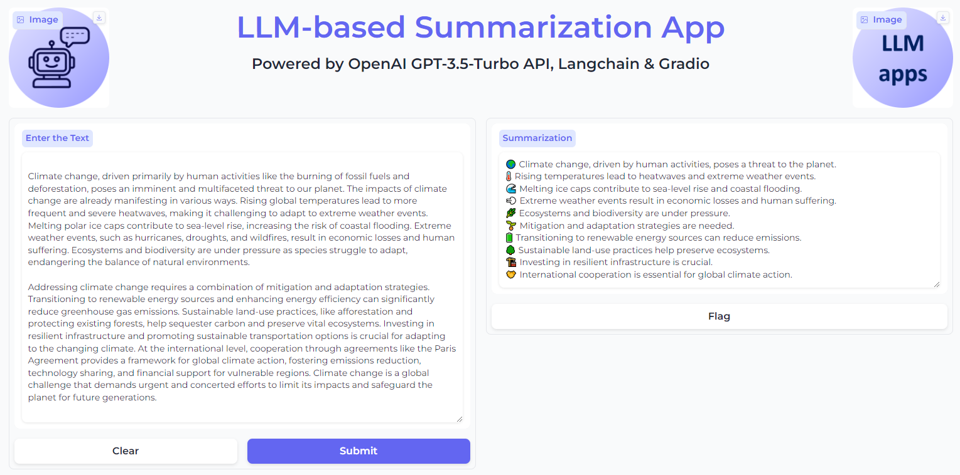
Summarization AI Assistant

Slide 34
Interview AI Assistant

Slide 35
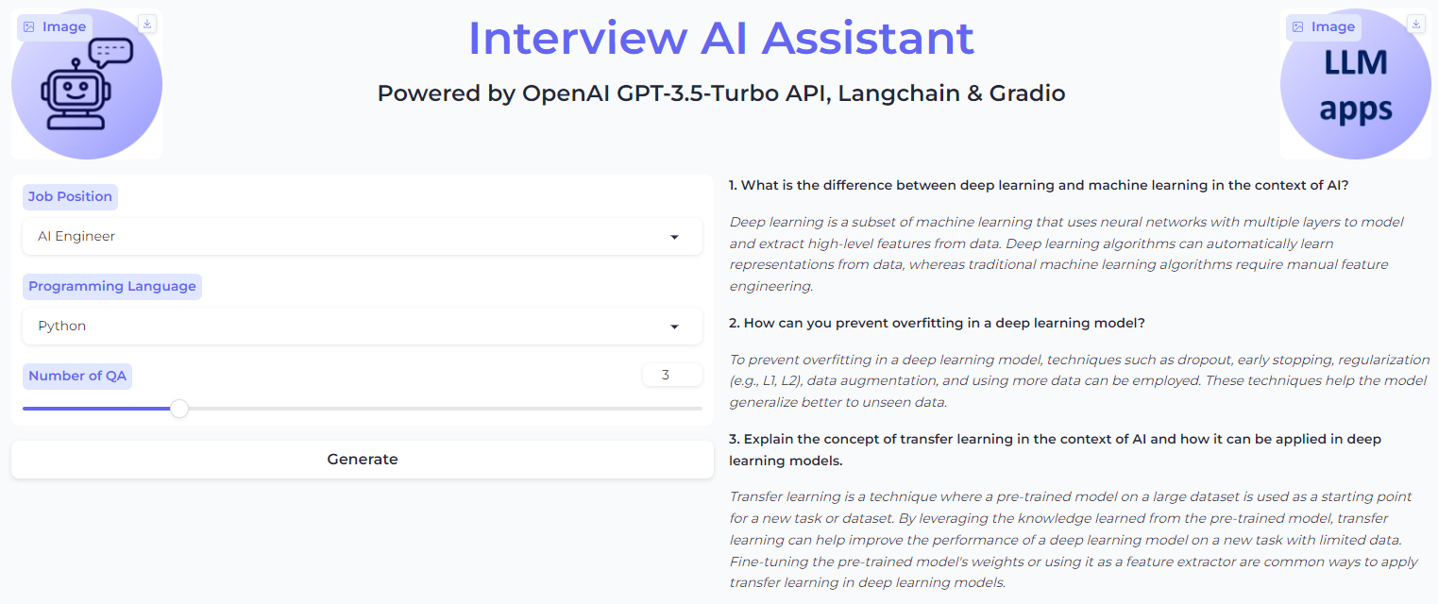
Interview AI Assistant

Slide 36
Simple AI Chatbot

Slide 37

Simple AI Chatbot
Trained on publicly available, non-private data up to a certain point in time.
Answer
Question
LLMs
Chat interface
User
AI Chatbot

Slide 38
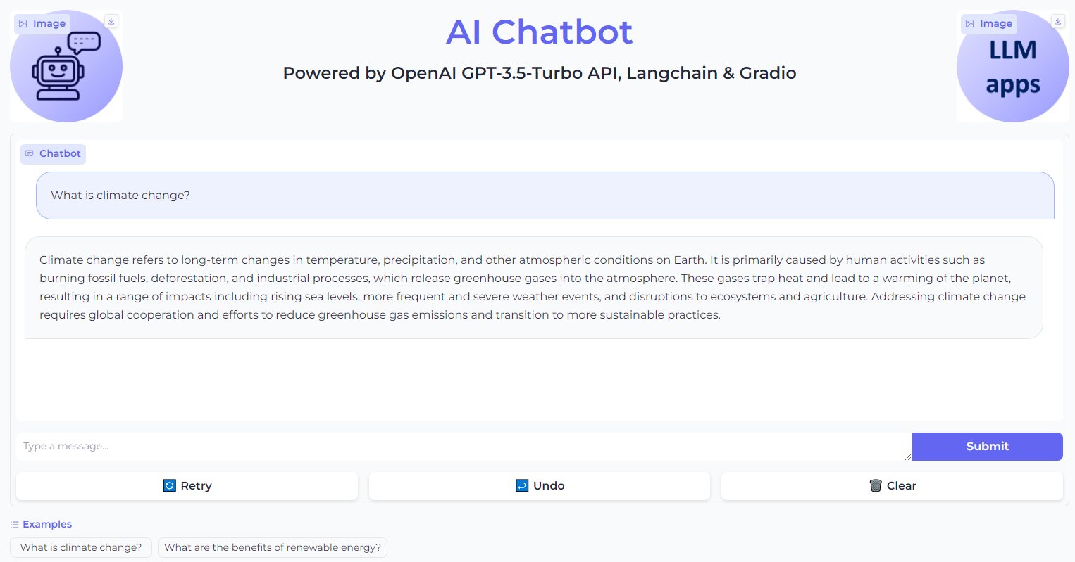
Simple AI Chabot Demo

Slide 39
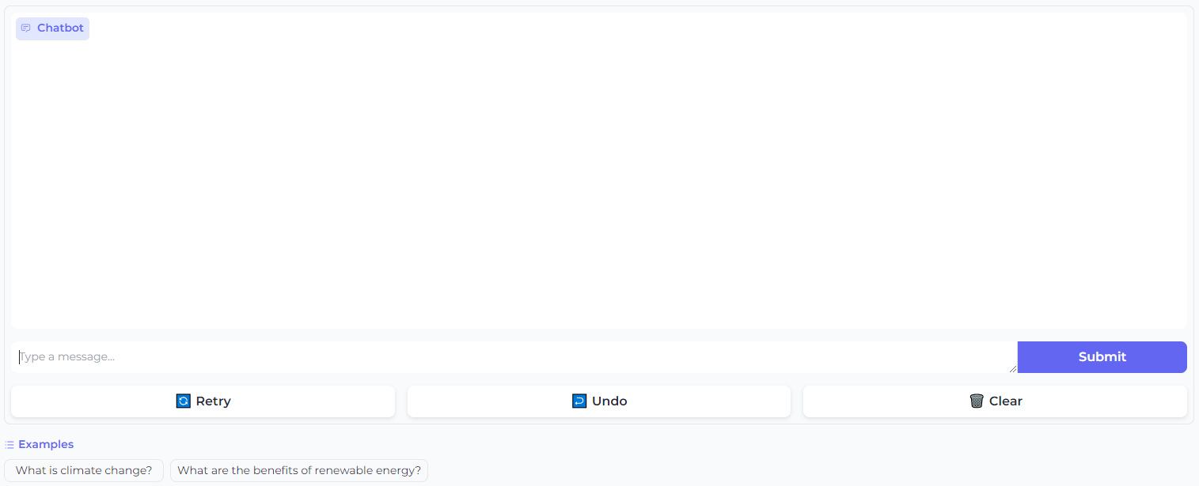
Chat Interface Block
gr.ChatInterface(
predict,
examples=["What is climate change?", "What are the benefits of renewable energy?"],
)

Slide 40
Simple AI Chabot Without Memory
# Initialize the chat model, i.e. gpt-3.5-turbo
llm = ChatOpenAI(temperature=0, model_name="gpt-3.5-turbo")
# Define prompt template
prompt_template = '''
You are a helpful chatbot.
Return consistent and accurate answers for the following question.
Human: {question}
AI:
''' # Define prompt from template
prompt = ChatPromptTemplate.from_template(prompt_template)
# Define the chatbot chain
chain = prompt | llm | StrOutputParser()
# Define the inputs for the chatbot
inputs = {"question": question}
# Get the chatbot's response
llm_response = chain.invoke(inputs)

Slide 41
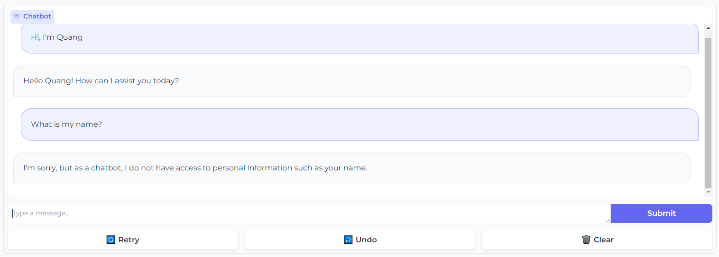
Simple AI Chabot Without Memory

Slide 42
Simple AI Chabot With Memory
# Initialize the chat model, i.e. gpt-3.5-turbo
llm = ChatOpenAI(temperature=0, model_name="gpt-3.5-turbo")
# Define prompt template
prompt_template = '''
You are a helpful chatbot.
Here is the conversation history:
{history}
Return consistent and accurate answers for the following question.
Human: {question}
AI:
''' # Define prompt from template
prompt = ChatPromptTemplate.from_template(prompt_template)
# Initialize the conversation memory
memory = ConversationBufferMemory(return_messages=True)
# Define the chatbot chain
chain = RunnablePassthrough.assign(
history=RunnableLambda(memory.load_memory_va riables) | itemgetter("history"))
| prompt | llm | StrOutputParser()
# Define the inputs for the chatbot
inputs = {"question": question}
# Get the chatbot's response
llm_response = chain.invoke(inputs)
# Save the context for the next conversation turn
memory.save_context(inputs, {"output": llm_response})

Slide 43
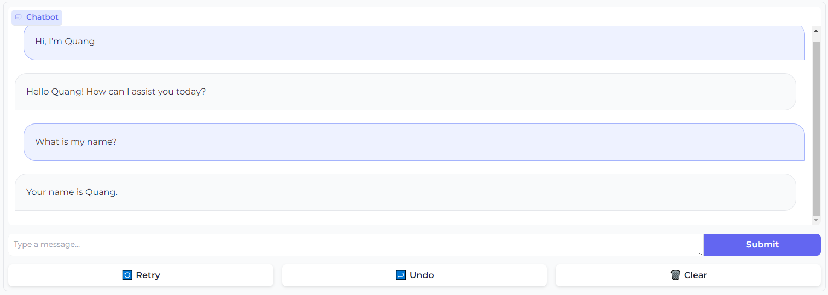
Simple AI Chabot With Memory

Slide 44
RAG-based AI Chatbot

Slide 45
Simple AI Chatbot Limitations
What's about
Recent knowledge?
Private knowledge?
Trained on publicly available, non-private data up to a certain point in time.
Answer
Question
LLMs
Chat interface
User
AI Chatbot

Slide 46
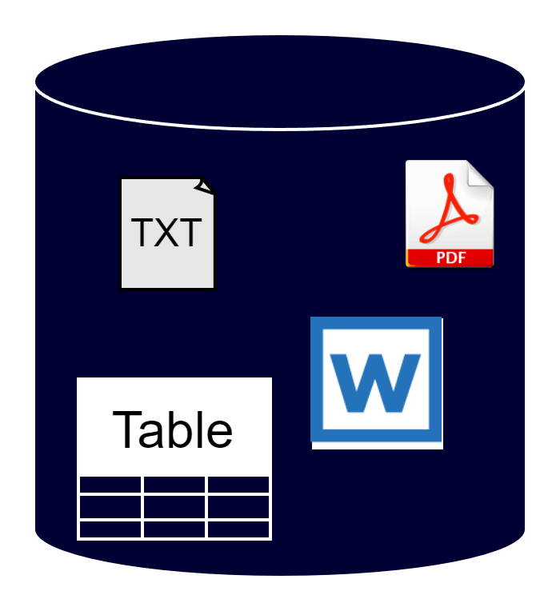
RAG-based AI Chatbot
Trained on publicly available, non-private data up to a certain point in time.
Answer
Information retrieval
Question
LLMs
User
Up-to-date
or private data source
AI Chatbot

Slide 47
RAG-based AI Chatbot
3 steps to build a RAG-based AI Chatbot
Generating vector database
Information retrieval
Augmented generation + Chat UI

Slide 48
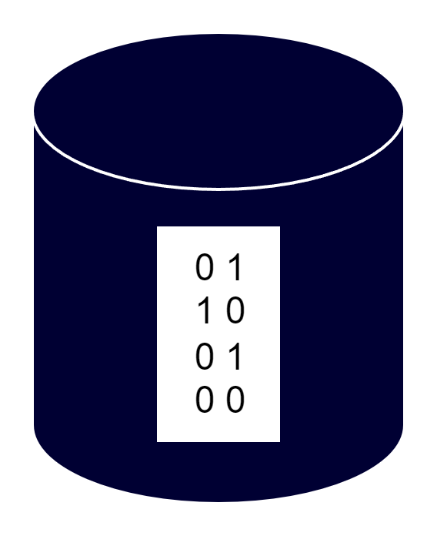
Generating Vector Database (1/3)
Data loading
Vector Embedding
Up-to-date
or private data source
Vector database

Slide 49
Information Retrieval (2/3)
User's question
Embedding
Vector database
Similarity search
Top-k retrieved information
(i.e. chunks of text)

Slide 50
Augmented generation + Chat UI (3/3)
Trained on publicly available, non-private data up to a certain point in time.
Answer
Top-k retrieved information
(i.e. chunks of private text)
Question
LLMs
User
AI Chatbot

Slide 51
RAG-based AI Chatbot Implementation
from langchain.chat_models import ChatOpenAI
from langchain.vectorstores.faiss import FAISS
from langchain.prompts import PromptTemplate
from langchain.text_splitter import CharacterTextSplitter
from langchain.schema.runnable import RunnablePassthrough
from langchain.document_loaders import PyPDFLoader
from langchain.embeddings import OpenAIEmbeddings
from langchain.schema import StrOutputParser
# Create chunks of text
loader = PyPDFLoader(file_path)
documents = loader.load()
text_splitter = CharacterTextSplitter(chunk_size=300, chunk_overlap=0)
texts = text_splitter.split_documents(documents)
# Create vector store vectorstore = FAISS.from_documents(documents=texts, embedding=OpenAIEmbeddings())
# Create retriever retriever = vectorstore.as_retriever(search_kwargs={"k": 1})

Slide 52
RAG-based AI Chatbot Implementation
# Initialize the OpenAI model
llm = ChatOpenAI(model_name="gpt-3.5-turbo", temperature=0)
# Define the prompt template for the chatbot
prompt_template = """
You are an assistant for question-answering tasks. Use the following pieces of retrieved context to answer the question.
If you don't know the answer, just say that you don't know.
Question: {question}
Context: {context}
Answer:
"""
# Create the prompt template for the chatbot
prompt = PromptTemplate(
input_variables=["question", "context"],
template=prompt_template,
)
# Create the LangChain
rag_chain = (
{"context": retriever, "question": RunnablePassthrough()}
| prompt
| llm
| StrOutputParser()
)
def make_llm_response(question):
# Generate a response to the message
llm_response = rag_chain.invoke(question)
return llm_response
# Question example
question = "What is the topic of this document?"
make_llm_response(question)

Slide 53
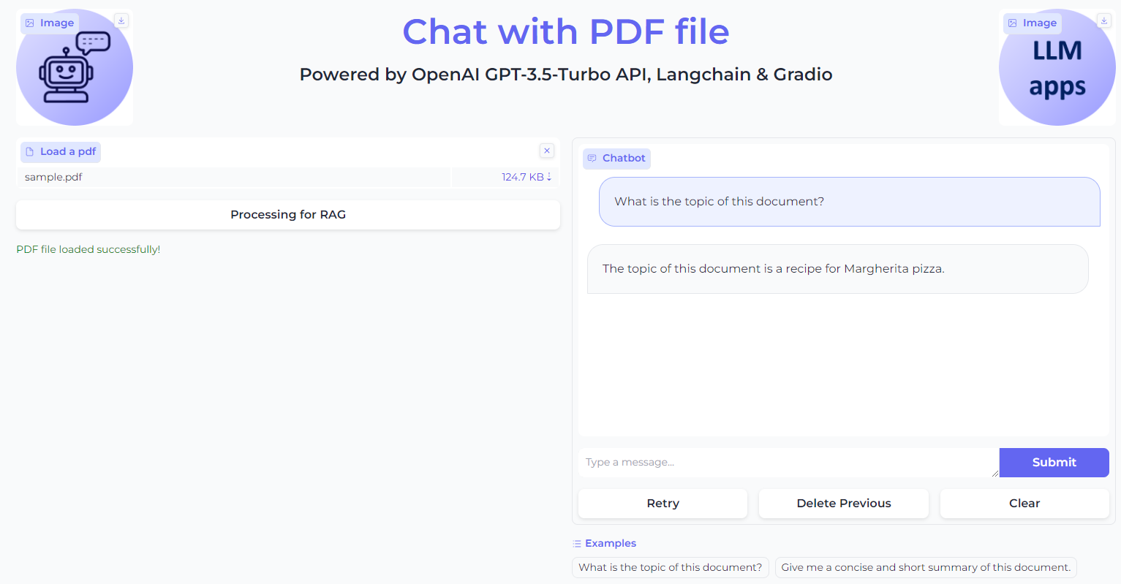
RAG-based AI Chatbot Demo

Slide 54
Agent-based AI Chatbot

Slide 55
What are some other limitations of AI Chatbot ?
How to access to the daily news?
How to do the math?
ect.
Trained on publicly available, non-private data up to a certain point in time.
Answer
Question
LLMs
Chat interface
User
AI Chatbot

Slide 56
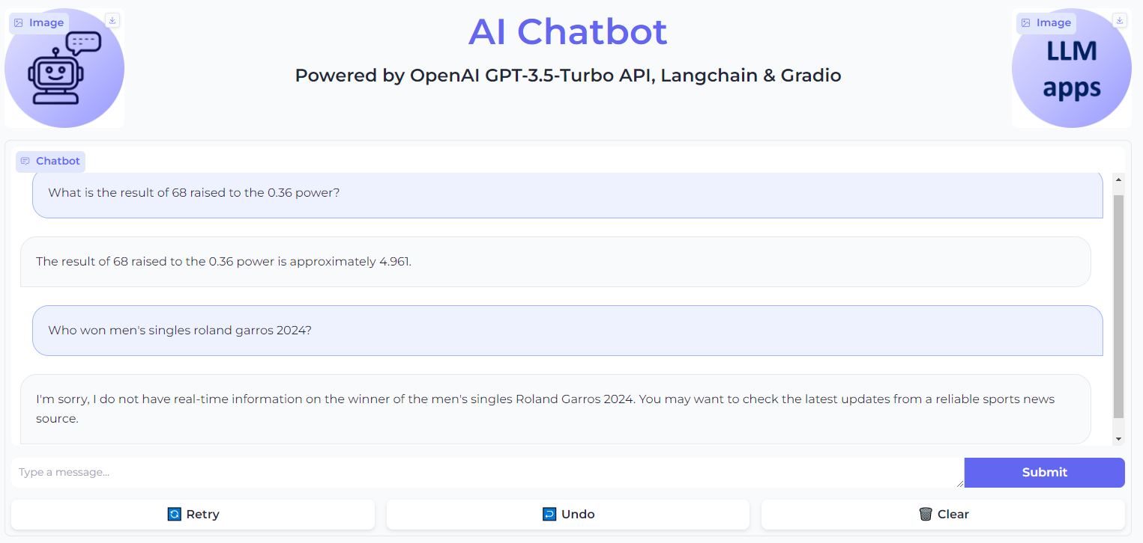
Examples of AI Chatbot Limitations

Slide 57


Agent-based AI chatbot
Trained on publicly available, non-private data up to a certain point in time.
Response
Answer
Search tools
Query
Question
Math tools
LLMs
Chat interface
User
External tools
AI Chatbot

Slide 58
AI Chatbot with Math Problems

Slide 59
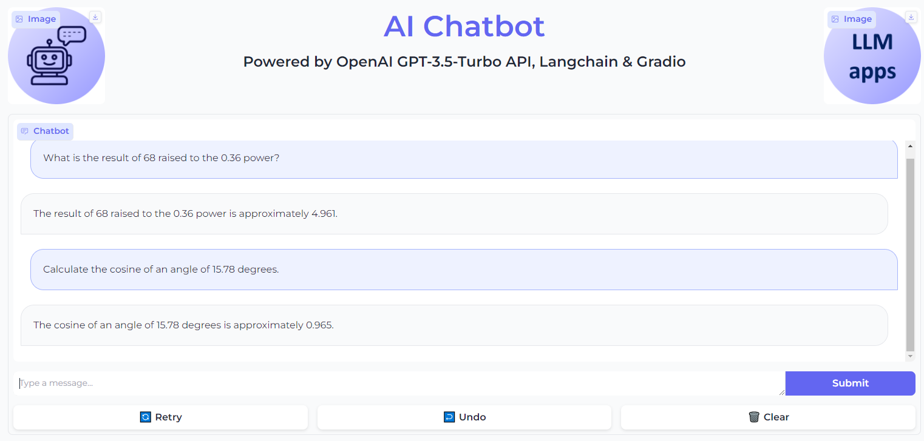
AI chatbot without Math Tools

Slide 60
AI Chatbot with Basic Math Tool
def main():
global agent
load_dotenv()
# Initialize the language model
llm = ChatOpenAI(temperature=0, model_name="gpt-3.5-turbo")
conversational_memory = ConversationBufferMemory(
memory_key="chat_history",
return_messages=True,
)
llm_math = LLMMathChain(llm=llm)
# Initialize the math tool
math_tool = Tool.from_function(
name="Calculator",
func=llm_math.run,
description="Useful for when you need to answer questions about math.",
)
# Define the set of tools for the agent
tools = [math_tool]
# Initialize the agent with the set of tools, the language model, and the conversation buffer memory
agent = initialize_agent(
tools=tools,
agent="chat-conversational-react-description",
llm=llm,
verbose=True,
handle_parsing_errors=True,
early_stopping_method="generate",
memory=conversational_memory,
)
# Return the initialized agent
return agent

Slide 61
AI Chatbot with Basic Math Tool
def predict(message, history):
# Check if the agent is None
if agent is None:
# If the agent is None, call the main function to initialize the agent
main()
# Run the agent with the user's message to generate a response
agent_response = agent.run(message)
# Return the response from the chatbot
return agent_response

Slide 62
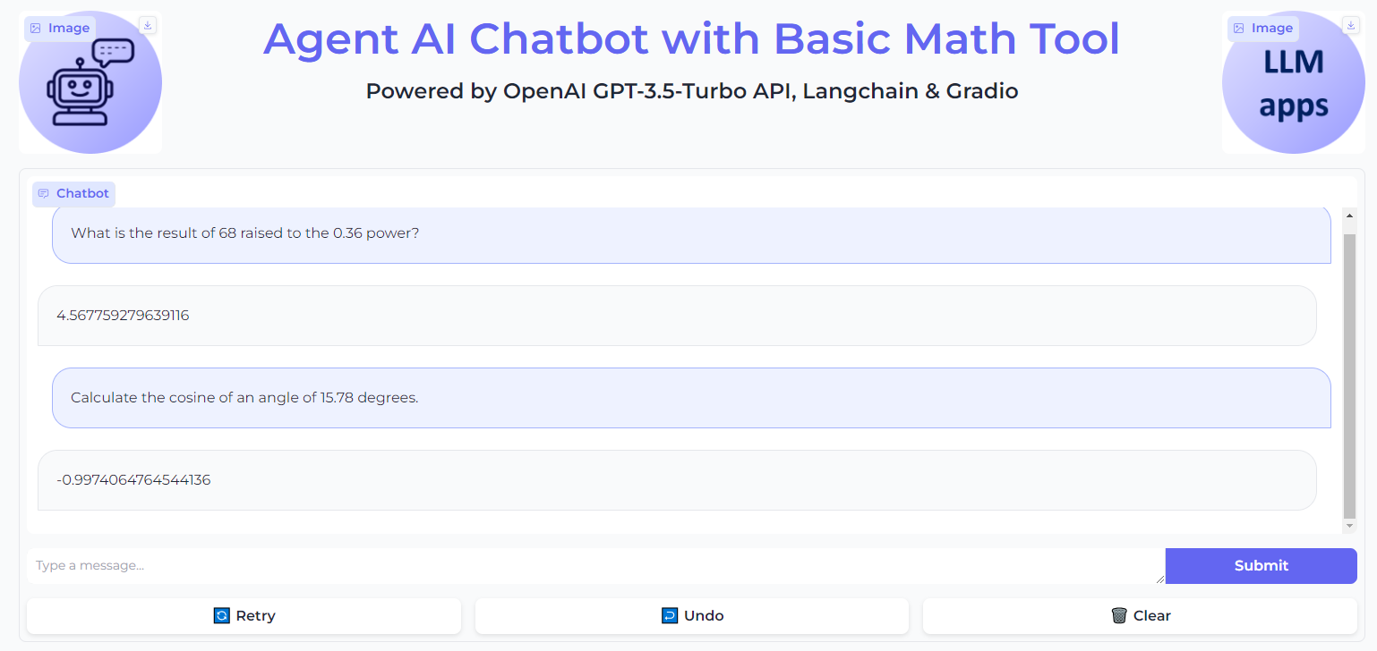
Agent AI Chatbot with Basic Math Tool

Slide 63
AI Chatbot with Customized Math Tools
class CosineDegreeTool(BaseTool):
name = "Cosine calculator"
description = "Use this tool when you need to calculate the cosine of an angle in degrees"
def _run(self, angle: Union[int, float]):
# Convert the angle from degrees to radians and calculate the cosine
return math.cos(math.radians(float(angle)))
def _arun(self, angle: int):
# Raise a NotImplementedError because this tool does not support async
raise NotImplementedError("This tool does not support async")
def main():
…
# Define the set of tools for the agent
tools = [math_tool, CosineDegreeTool()]
…

Slide 64
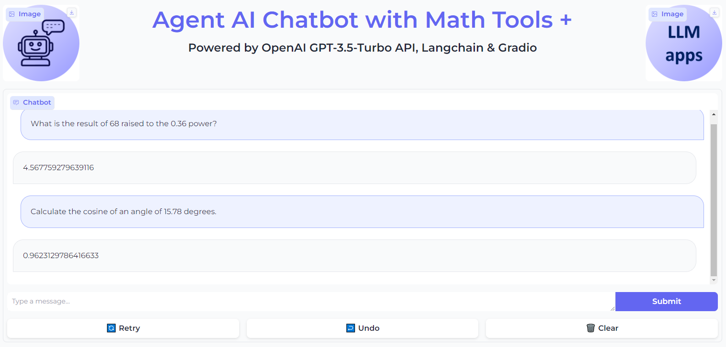
AI Chatbot with Customized Math Tools

Slide 65
AI Chatbot with Search Problems

Slide 66
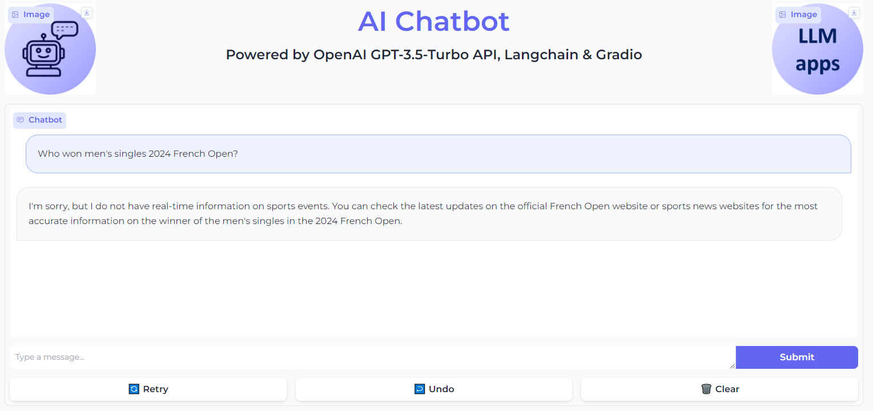
AI Chatbot without Search Tool

Slide 67

AI Chatbot Agent with Search Tool
def main():
global agent_executor
load_dotenv()
tools = [TavilySearchResults(max_results=1)]
chat = ChatOpenAI(model="gpt-3.5-turbo", temperature=0) prompt = ChatPromptTemplate.from_messages(
[(
"system",
"You are a helpful assistant. You may not need to use tools for every query - the user may just want to chat!",
),
MessagesPlaceholder(variable_name="messages"),
MessagesPlaceholder(variable_name="agent_scratchpad")
]) agent = create_openai_tools_agent(chat, tools, prompt) agent_executor = AgentExecutor(agent=agent, tools=tools, verbose=True) return agent_executor
def predict(message, history):
# Check if the agent variable is None
if agent_executor is None:
main()
agent_response = agent_executor.invoke(
{"messages": [HumanMessage(content=message)]})
# Return the response from the agent
return agent_response['output']

Slide 68
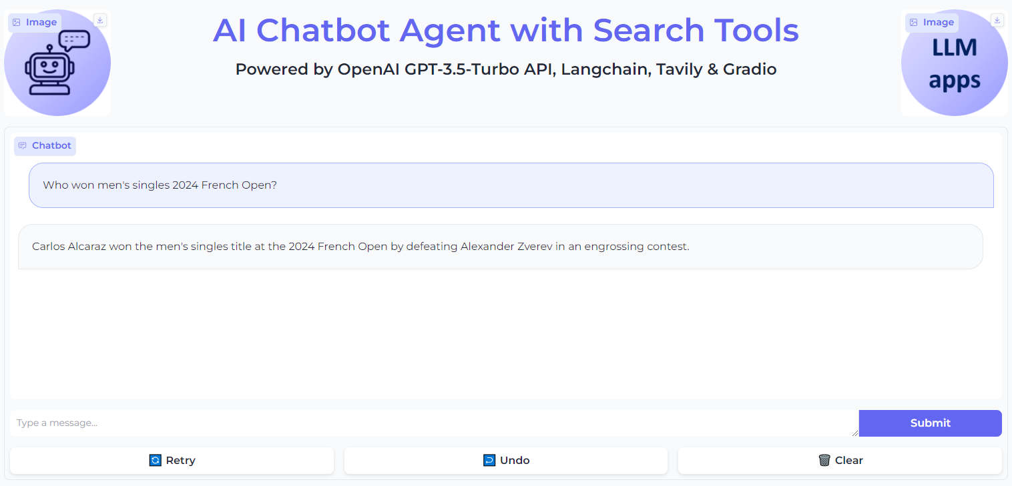
AI Chatbot Agent with Search Tool

Slide 69
What We Have Learned

Slide 70
In summary
Leveraging different frameworks to build LLM-based web application demos
Backend
Python, LangChain, OpenAI API, FAISS, external tools: Wikipedia, Tavilty, etc.
Frontend
Python, Gradio
Learnt to build 4 types of LLM-based application
Task-specific AI assistants
Simple AI chatbot
RAG-based AI chatbot
Agent-based AI chatbot

